Slide 1
SWEN90016 Software Processes & Project Management
Quality Assurance
Planning, Control, Monitoring
2019 – Semester 2
Tutorial 8
Copyright University of Melbourne 2017

Slide 2
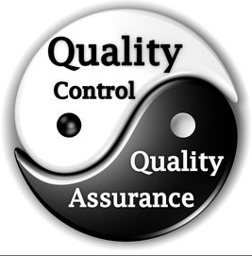
Today’s aim
Know quality compliance frameworks, and their pros and cons
Know the different tools for achieving high quality outcomes
Discuss the costs and benefits of quality

Slide 3
Software Maturity Model
1.
What are the advantages of moving a software process from “repeatable” to “defined” ? (choose all that are correct)
a) A defined software process has measurement and control processes in place to encourage good management of the project
b) Less costly on the project team
c) It enables less experienced managers to perform as well as highly experienced managers.
d) Good for team morale

Slide 4
Software Maturity Model
2.
What are the disadvantages of moving a software process from “repeatable” to “defined” ? (choose all that are correct)
a) It is difficult to manage because there are fewer guidelines
b) Expensive
c) It does not provide opportunities for junior managers to gain skills
d) Can be problematic for team morale and interpersonal relationships

Slide 5
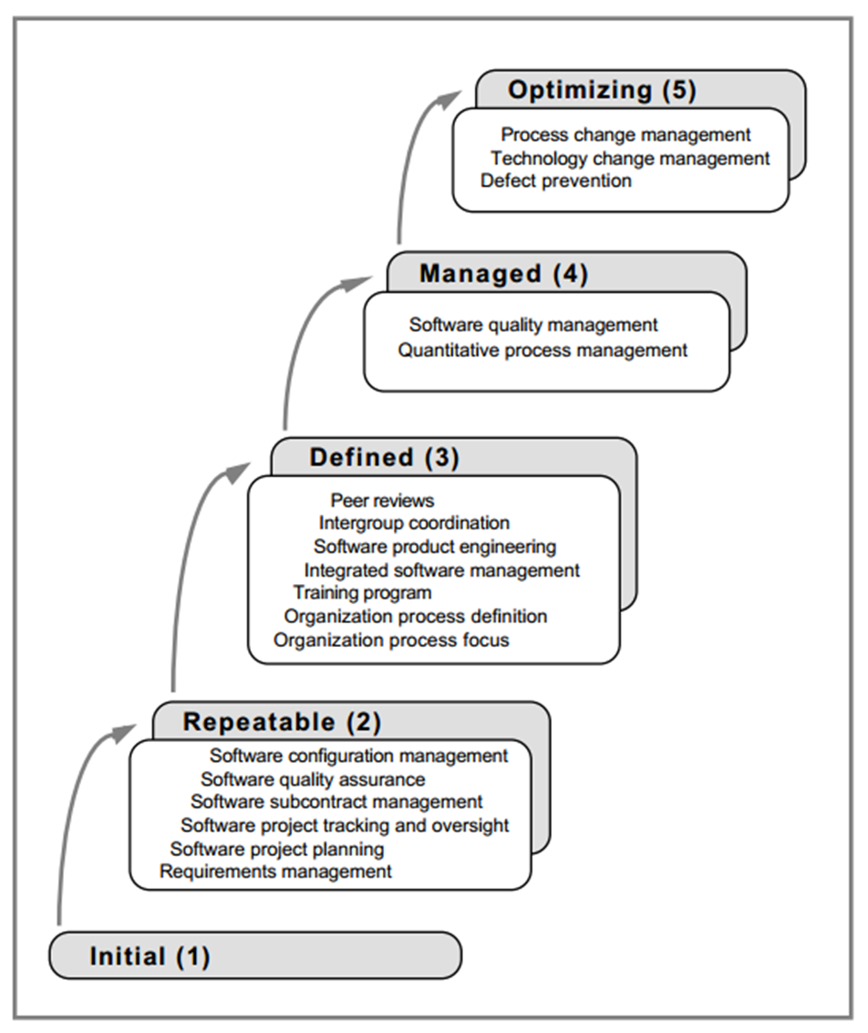
CMM
Capability Maturity Model
A tool for achieving high quality
From Lecture 9, slide 34

Slide 6

Software Maturity Model
From Lecture 9, slide 35
1.
What are the advantages and disadvantages of moving a software process from “repeatable” to “defined” ?

Slide 7
Verification Process
In your assignment groups, discuss quality processes & do these activities
2.
Create an appropriate formal checklist to review your own group assignment
3.
Describe the outcome of this review?

Slide 8
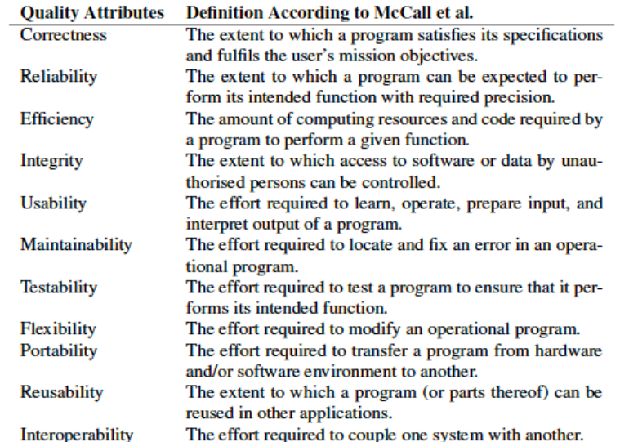
Quality Plan: A checklist
A tool

Slide 9
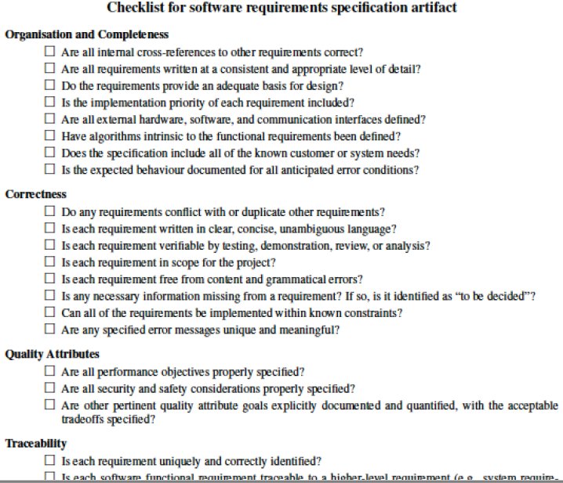

Another checklist
A tool

Slide 10
Verification Process
Quick video when on the importance of SW quality
https://www.youtube.com/watch?v=x8JR9Lh4XJ0

Slide 11
Agile Quality Strategy
What is the role of QA in agile?
After development there is a separate testing done by the agile team in a number of sprints
As there is fast development cycles there is no time for testing
Agile aims to adapt to changes quickly and minimize time so there is no testing
Testing is done in each sprint
e) Continuous integration between development and testing

Slide 12
Agile Quality – Dev Team process
Agile QA desk-audit hurdle:
Invite multi skilled audience to desk audit: a business analyst, another developer and a tester
Review the code at the developer’s desk, before the code is allowed to be committed into the shared git repository, GITHub.
Once the code is committed into GITHub, it’s test suite is run immediately by the Continuous Integration tool
CI tool displays run code’s pass/fail status

Slide 13
Agile Quality Process
What
Where
Who
When
Why
Sprint Review QA evaluation:
Build small piece of working software with minimal features
Showcase the product chunk to the stakeholders early
Fail fast and as cheaply as possible, & get timely feedback
Capture the technical debt item in the Product Backlog, (optionally in FDD format)
The Product Owner sets the priority of the technical debt item

Slide 14
QA Requirements
Write QA Requirements as User Stories
As the Agile Scrum team:
As a Quality Assurance Design team:
As the System Administrator:
5 a.
We want a Quality Plan, so that our Sprint has a strong Quality Management focus
b.
We want a QA checklist, so that key categories and attributes are assessed at defined times
c.
I want a password policy guideline, so that our application has helpful processes
I want a password policy checklist, so that our application is highly secure

Slide 15
Done!

Slide 16
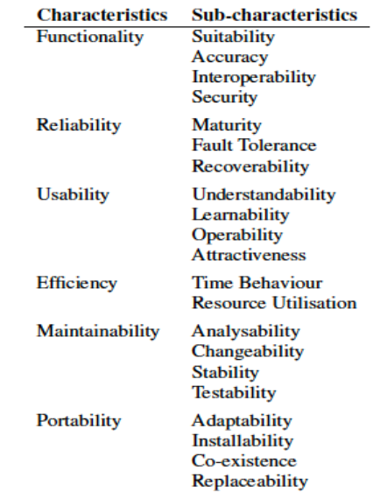

ISO-9000 Standards
ISO-9126: SW Quality
A compliance framework for achieving high quality
http://www.sqa.net/iso9126.html

